Slide 1

Rusterizer Masterclass Going 3d
Luca Quartesan – quartesan.l@buas.nl – 03-10/02/2021

Slide 2
Welcome v0.2
Features that we are not going to implement are marked with 🚩
🚩are left behind so you can expand on what we see during the lectures

Slide 3
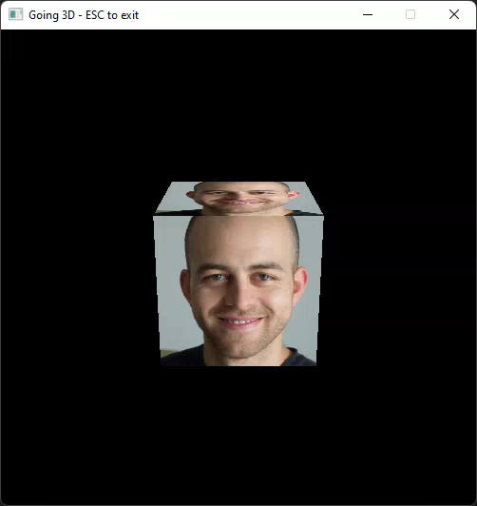
Agenda
Last Episode
3D Transformations
Camera
Viewport Transformations
Rotating Cube

Slide 4
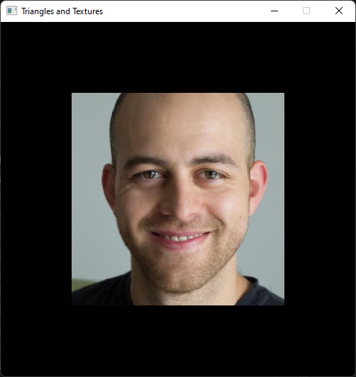
Last Episode
Vertex attributes describe position and other surface parameters
We can map textures to surfaces
When rasterizing a surface we interpolate the vertex attributes
We can do this with barycentric coordinates
Barycentric coordinates ⚖️ weights
how close we are to a vertex
how much a that vertex contributes
Let’s have a look at testing in rust first ☺

Slide 5
Transformations
2D/3D transformations done with matrices
Vector * Matrix
Matrix * Matrix

Slide 6
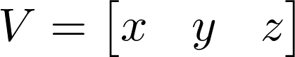
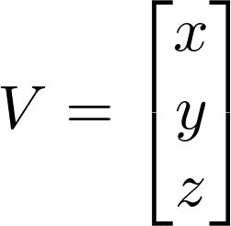
Column vs Row major
Vectors can be expressed as matrices:
Row Major (1,3)➡️
Column Major (3,1) ↘️
One is the Transpose of the other
This choice influences the orders of matrix multiplication

Slide 7
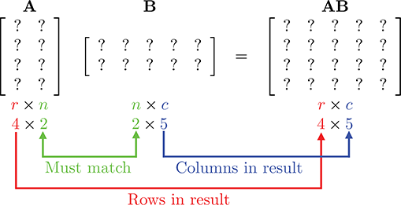
Matrix multiplication
Inner dimensions must match.
Outer dimension = resulting shape
https://gamemath.com/book/figs/matrixintro/matrix_multiplication_result_size_rules.png

Slide 8
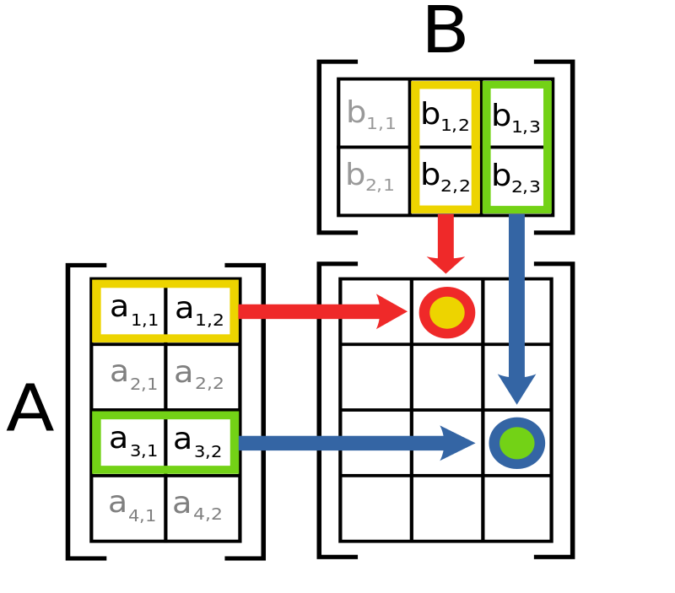
Matrix multiplication

Slide 9

Vector * Matrix (Row Major)
V*M➡️

Slide 10
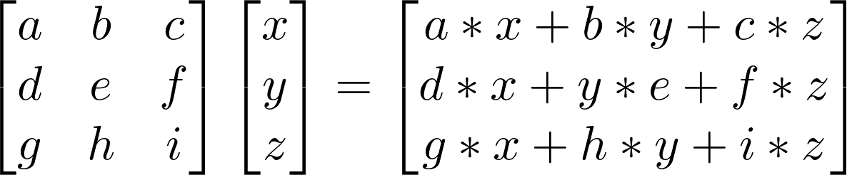
Matrix * Vector (Column Major)
M*V ⬅️
We will stick with column major throughout the lessons

Slide 11
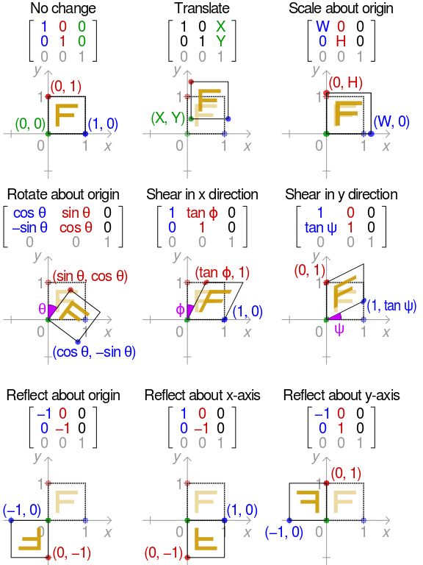
2D Transformations
https://en.wikipedia.org/wiki/Transformation_matrix

Slide 12


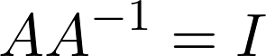
Identity Matrix
Identity
Invertible
Mat x Inverse = identity

Slide 13
Concatenate transformations
A.k.a. matrix multiplication
We can concatenate transformations using matrix multiplication
But order matters

Slide 14
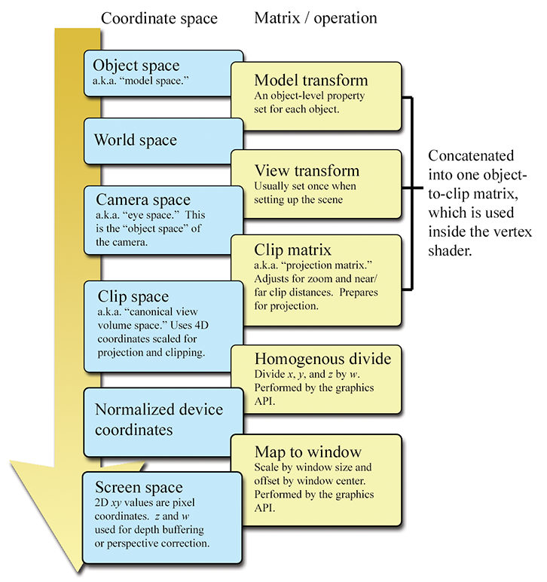
Coordinate Systems/Spaces
During a rasterization pipeline we transform our vertices between different coordinate spaces
Each is accompanied by a matrix
Except for the viewport transformations
https://gamemath.com/book/figs/graphics/coordinate_spaces_summary.png

Slide 15
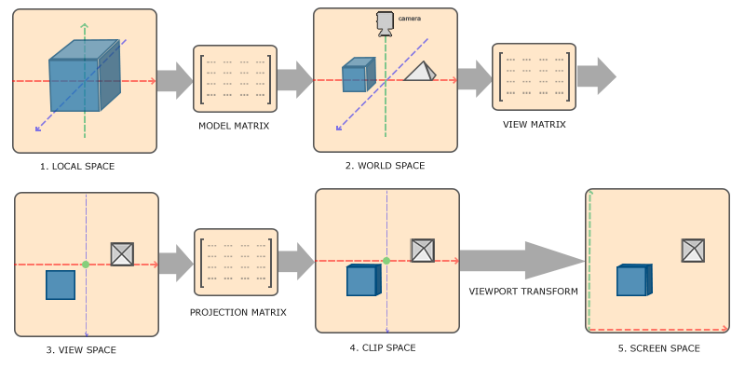
Coordinate Systems
https://learnopengl.com/Getting-started/Coordinate-Systems

Slide 16
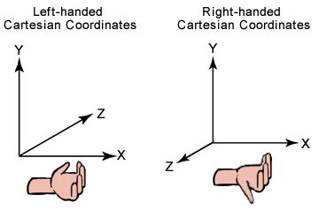
3D Coordinate systems
We are going for RH
https://docs.microsoft.com/en-us/previous-versions/windows/desktop/bb324490(v=vs.85)

Slide 17
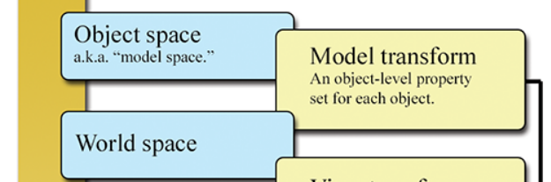

Model Matrix
We transform an object from “local” to “World” space
Consists in 3 matrices:
Scale
Rotation
Translation

Slide 18
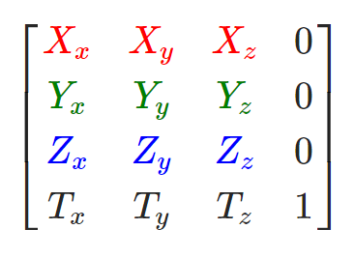
Model Matrix (Row)

Slide 19
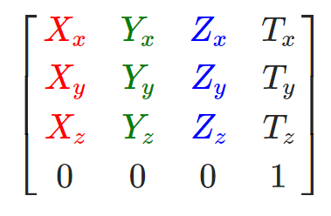
Model Matrix (column)

Slide 20
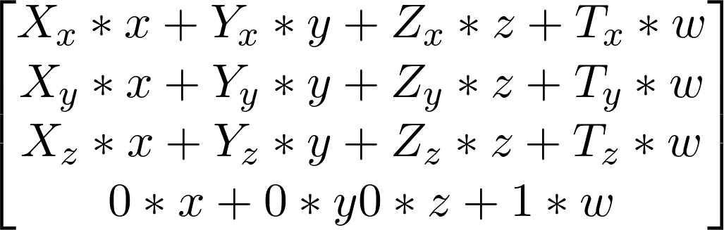
Model Matrix (column)
If we are describing a point w=1 👉 Translation
If we are considering a vector w=0 ⛔ Translation

Slide 21
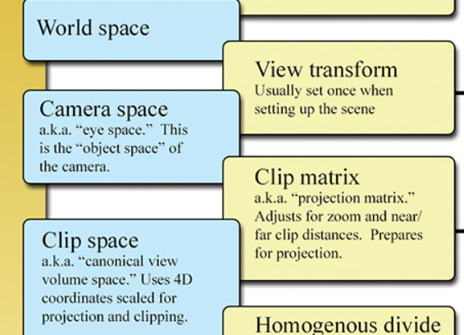
Camera
Finally introduce the concept of camera
Consists in 2 operations:
View
Projection/Clip
View and projection are done through matrices
Different between RH or LH👈

Slide 22
View Matrix
Brings the whole scene from the perspective of a camera:
Camera is at the centre of the “world”
World from camera point of view
Usually calculated using the a LookAt matrix
Position,
Forward Direction
Up Direction

Slide 23
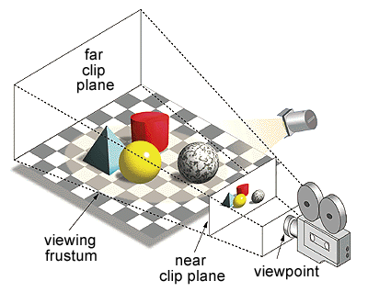
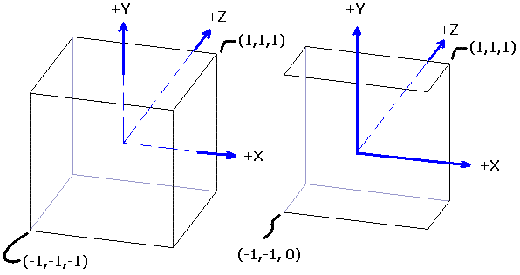
Projection Matrix
The goal is to map view volume to a unit cube
Either:
Orthographic: rectangular parallelepiped
Perspective: Frustum
https://gdbooks.gitbooks.io/3dcollisions/content/Chapter6/frustum.html

Slide 24
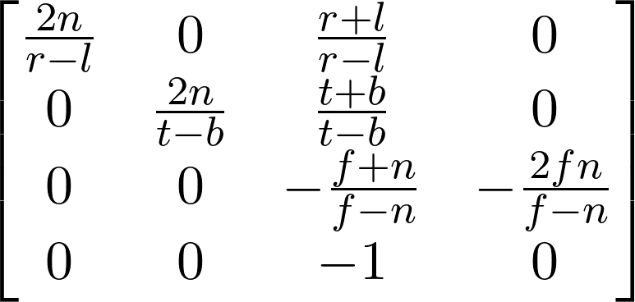
Perspective Projection
The goal is to map the frustum to a unit cube

Slide 25
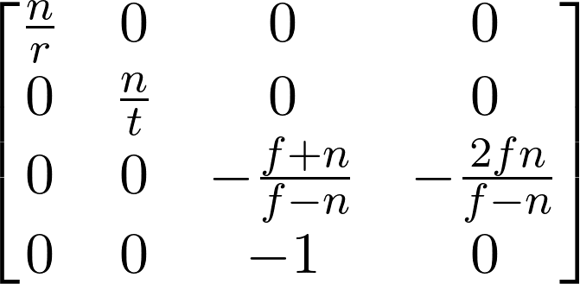
Perspective Projection
Since our viewing frustum is symmetric in x and y

Slide 26
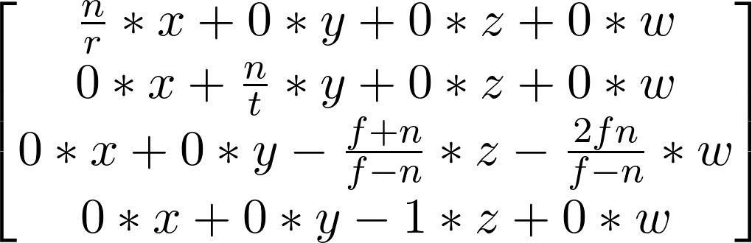
Perspective projection
Let’s multiply our vector for the matrix

Slide 27
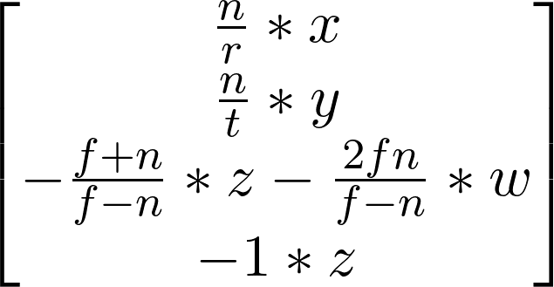
Perspective projection
🥸clip space w = view z (and a – because of rh coordinates system)

Slide 28

Putting it all together MVP
We can concatenate these 3 operations in a single matrix:

Slide 29
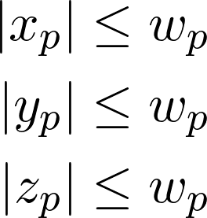
Clip space
Projection matrix
clip coordinate system is a homogeneous coordinate system
the name comes from the fact that we do clipping in this space.. more on that the next episode
Projects the frustum into a volume

Slide 30
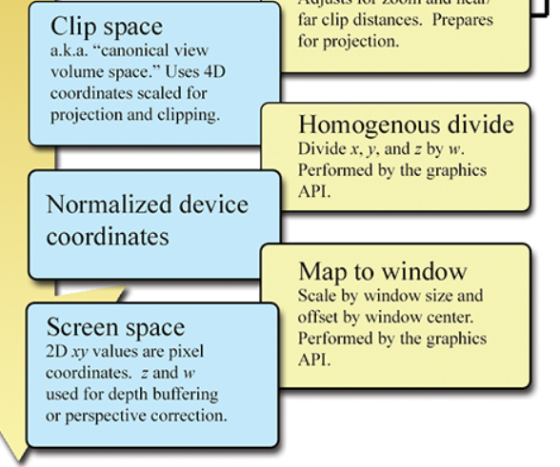
Viewport Transformations
Perspective/homogenous divide
Map to viewport/window

Slide 31
Perspective Divide
Normalizes Clip space by dividing for w (= z in view space)
W normalizes this values based on the view frustum
Resulting in Normalized device coordinates (NDC)
Also called perspective/homogenous divide

Slide 32
Map to viewport
Simply maps from [-1, 1] to viewport size
Remember that the y on the window is inverted!

Slide 33
Rotating quad
What is going on?

Slide 34
Perspective correction
Affine mapping:
Does not take depth into account
Perspective correct mapping:
Take depth into account

Slide 35
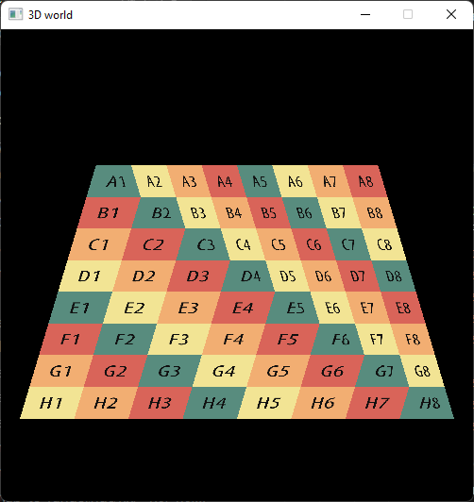
Affine Mapping
the problem is that we are interpolating the texture values in screen space instead of 3D, therefore discarding depth information

Slide 36
Perspective correction
When we interpolate our parameter
we divide-first-then-interpolate➡️, since we are past NDC (we divided by w)
projection ➡️ Interpolation
what would have been the parameter β if we had interpolate-first-then-divide ⬅️
Interpolation ➡️ projection
We want to interpolate in 3D

Slide 37
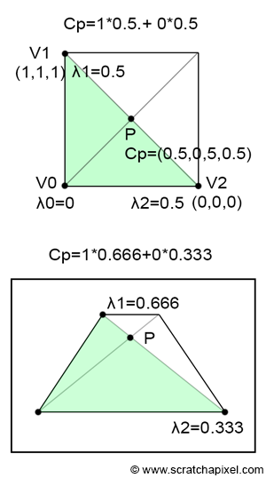
Perspective correction
We need to take also the difference in depth (z)
We can use view z (🥸)
https://www.scratchapixel.com/lessons/3d-basic-rendering/rasterization-practical-implementation/perspective-correct-interpolation-vertex-attributes

Slide 38
Perspective correction
Divide attributes by their z (reciprocals)
Then interpolate the attributes and z
Multiply attribute by interpolated z
https://www.scratchapixel.com/lessons/3d-basic-rendering/rasterization-practical-implementation/perspective-correct-interpolation-vertex-attributes

Slide 39
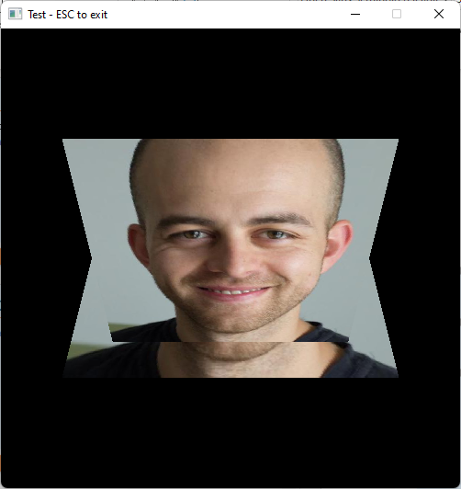
Adjusting the depth buffer
Also the depth requires “perspective correction”

Slide 40
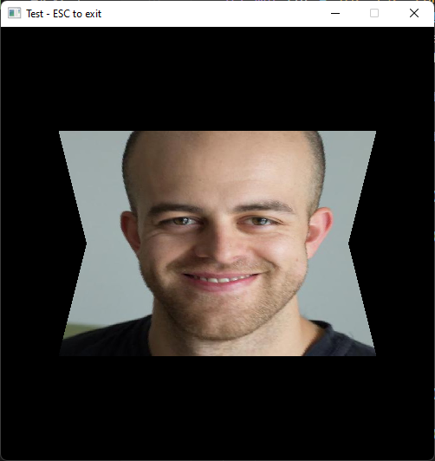
Adjusting the depth buffer

Slide 41
Rotating Cube
Concatenating “model” matrices to parent objects together
Let’s have a parent transform a 6 children to make a cube from our quad

Slide 42
Rotating Cube

Slide 43
Thank you! 🦀
Many questions?

Slide 44
You could try
Scene Graph-ish / parenting
Loading a model (we will see how to load a Gltf next eppi)
Moving camera

Slide 45
Resources
Rasterization: a Practical Implementation
Optimizing Software Occlusion Culling – index | The ryg blog
Texture Mapping & Polygon Rasterizing Tutorial (1/2) [C++20] – YouTube
3D Programming Fundamentals [Introduction] Tutorial 0 – YouTube
Rasterizer Algorithm Explanation – YouTube
https://paroj.github.io/gltut/Texturing/Tut14%20Interpolation%20Redux.html
http://www.songho.ca/opengl/gl_projectionmatrix.html

